Slide 1
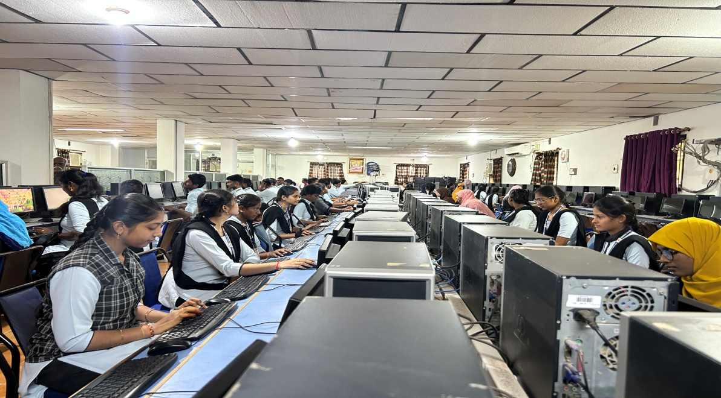
PHYSICAL FACILITIES – COMPUTER CENTRES
Computer Lab-1

Slide 2
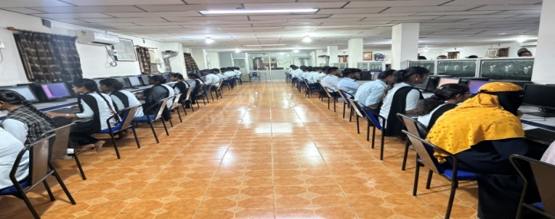
Computer Lab-2

